Slide 1

MINOR PROJECT-II PRESENTATION ON-MENTAL STRESS DETECTION USING VOICE TONE ANALYSIS
GANDHI INSTITUTE OF ENGINEERING & TECHNOLOGY UNIVERSITY,GUNUPUR,ODISHA
Presented By:
23UG010665-23CSE586-JAYA PRAKASH SAHOO
23UG010626-23CSE543-P.ROHIT KUMAR SUBUDHI
23UG010692-23CSE615-PIYUSH KUMAR TRIPATHY
Under the Guidance of
Mrs. Geetanjali Panda
Dept. of CSE
GIET University , Gunupur

Slide 2
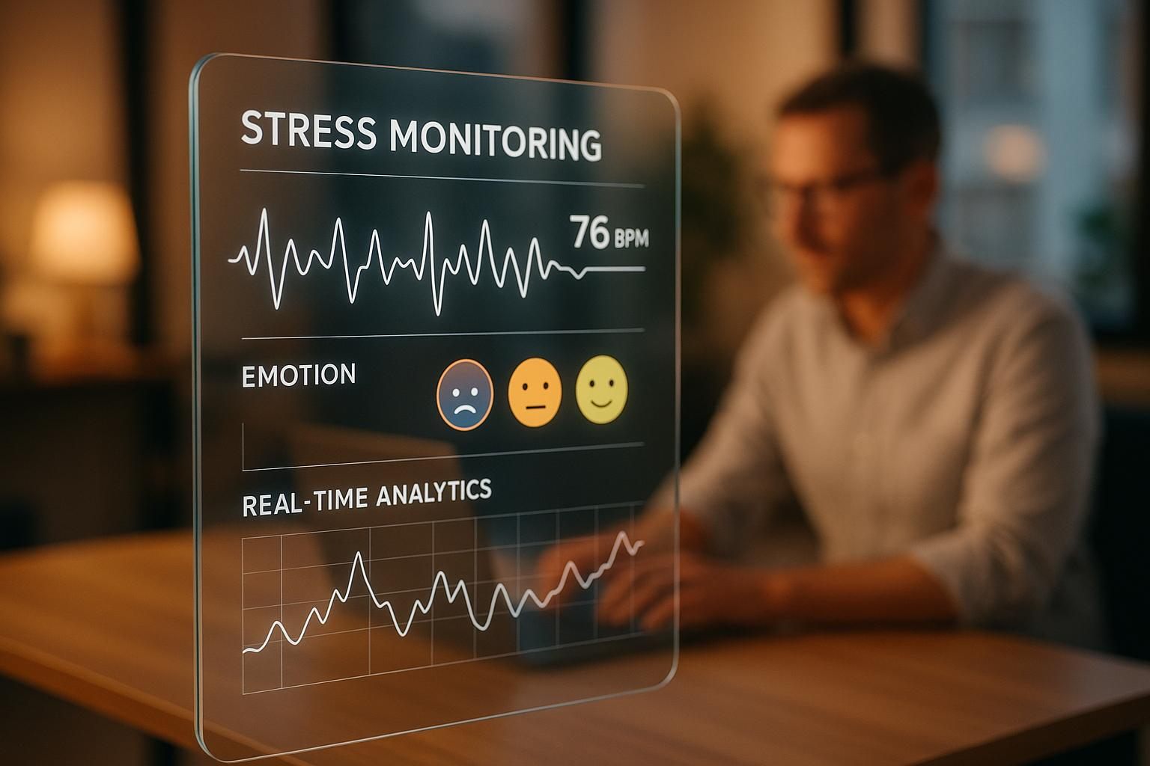
Contents:-
1. Problem Statement
2. Introduction
3. Technology Used
4. Features
5. Machine Learning Approach
6. Diagrams
7. Model Evaluation & Metrices
8. Future Enhancement
9.Limitations
10.Conclusion
11.References

Slide 3
1.PROBLEM STATEMENT
Measurement Error: Current stress tests rely on personal surveys, which are often inaccurate because of human bias or social stigma.
No Long-Term Tracking: Most clinical evaluations only happen once and fail to monitor how stress levels change throughout daily life.
Cost Effectiveness: Professional mental health consultations are often too expensive and time-consuming for the general public to access easily.
Invisible Signs of Stress: Stress causes tiny changes in vocal cords and breathing that are impossible for the human ear to detect without help.
More Waiting Time: Without a way to detect stress in real-time, people often only seek help after they have already reached burnout or depression.
Inappropriate Testing: Many existing objective medical tests are invasive and inconvenient for people who want to track their stress frequently.
Lack of Digital Tools: There is a major shortage of automated, non-invasive digital tools that can give immediate, data-driven feedback on a person's well-being.

Slide 4
2.INTRODUCTION
Project Overview: This project, "Mental Stress Detection Using Voice Tone Analysis," is an AI-powered system designed to monitor and analyze psychological well-being through vocal patterns.
Science of Voice
Stress causes automatic changes in the human body. It affects breathing patterns and increases tension in the vocal cords. These changes create variations in voice, which can be captured and analyzed using digital audio recordings.
Objective Analysis
Traditional mental health tests depend on personal feelings and opinions. This system uses voice data to measure stress levels objectively, making the analysis more accurate and reliable.
Real-Time Feedback
The application analyzes voice samples instantly. It displays the user’s stress level as Low, Moderate, or High and provides emotional insights through a personalized dashboard.
User-Centric Design
The application has a simple and modern web interface. Users can easily record their voice, view previous stress records, and receive helpful mental wellness tips.
Aim & Purpose
The aim of this project is to support mental healthcare using technology. It helps in early stress detection and improves emotional awareness in a scalable and user-friendly way.

Slide 5
3.TECHNOLOGY USED
Frontend
HTML – Creates the structure of the web application
CSS – Designs and styles the user interface
JavaScript – Records voice, sends audio to backend, displays results
Backend
Python Library– Core programming language
Flask – Handles server requests and audio file uploads
Machine Learning & Audio Processing
Librosa – Extracts voice features (MFCC, pitch, energy)
NumPy & Pandas – Data processing and analysis
Scikit-learn – Stress classification using ML algorithms
Tools
VS Code – Development environment
Live Server – Frontend execution
Browser Microphone API – Voice recording

Slide 6
4.FEATURES
Real-Time Voice Capture-The system records voice samples directly through the web browser using the Media Devices API. It captures clear and high-quality audio without needing any extra software or hardware.
Audio Signal Analysis-The application studies natural changes in a person’s voice caused by stress. It analyzes features like pitch, loudness, and frequency to identify emotional or mental stress.
Instant Stress Scoring-After recording, the system gives instant results. Stress levels are shown as Low, Moderate, or High, making them easy to understand.
Interactive Dashboard-Each user gets a personal dashboard. It shows total voice tests, average stress levels, and common emotions using simple visual indicators and charts.
Historical Tracking-The system stores past records so users can track their mental health over time. They can view stress patterns over days or months.
Dynamic Visualizations-During voice recording, live sound wave animations are displayed. After analysis, bar charts help users understand their stress probabilities clearly.
Wellness Recommendations-Based on the detected stress level, the system provides useful wellness tips. These tips help users relax and improve their mental well-being.

Slide 7
Data Collection & Pre-processing
The system records live voice through the web browser using the MediaDevices API. Background noise is reduced and the audio is normalized to make the voice clear and consistent.
Feature Extraction
The system extracts important voice features to detect stress.
MFCC is used to understand voice patterns and speech shape.
Prosodic features like pitch and loudness are measured, as stress usually increases voice frequency.
Voice variations such as small voice vibrations (jitter and shimmer) are analyzed, which occur due to muscle tension during stress.
Model Training & Classification
Machine learning models like Support Vector Machine (SVM) or Random Forest are used to classify stress levels.
The model is trained using standard emotional voice datasets such as RAVDESS and TESS.
Real-Time Prediction
The extracted voice features are sent to the trained model.
The system instantly predicts stress levels and displays results as Low, Moderate, or High.
5.MACHINE LEARNING APPROACH

Slide 8
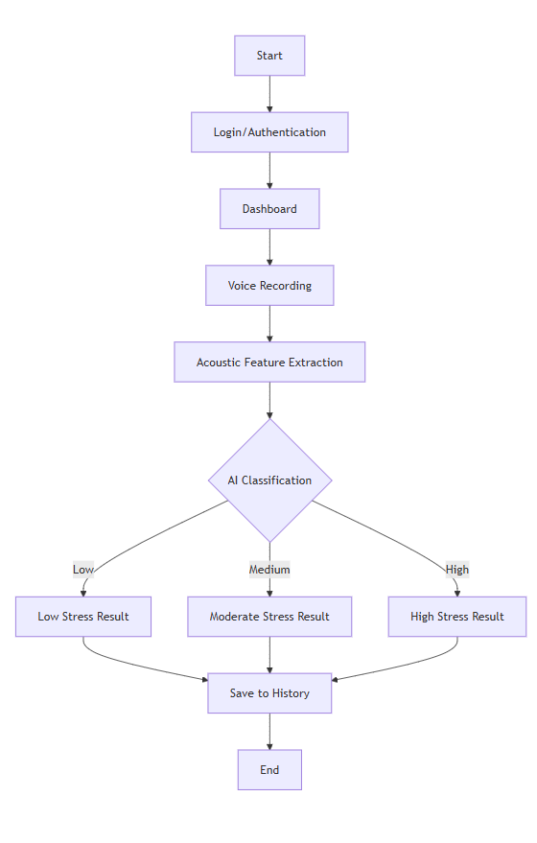
6.FLOWCHART
User opens the website.
User login or signs up.
System displays the dashboard.
User starts voice recording.
System detects the voice input.
System performs classification.
System displays the result (High / Moderate / Low).
Result is saved to history.
Process ends.

Slide 9
7.Model Evaluation & Metrices
Overall Accuracy: This tells us what percentage of the time the AI correctly identified the user's stress level (Low, Moderate, or High).
Reliability (No Missed Cases):Our priority is to ensure the system does not miss someone who is truly stressed. This is called "Recall."
Precision (No False Alarms):This ensures the AI doesn’t accidentally tell a calm person that they are stressed.
Error Checking: We use a chart (Confusion Matrix) to see where the AI gets confused—for example, if it is mixing up "Moderate Stress" with "High Stress."
Testing with Diverse Voices: We tested the system with many different voices (different ages, genders , accents) to make sure it works for everyone.

Slide 10
8.FUTURE ENHANCEMENT
Mobile Application Development: Transitioning from a web-based UI to a dedicated Android and iOS app for easier access and on-the-go stress monitoring.
Wearable Integration: Syncing with Smartwatches to combine voice data with heart rate (HRV) and sleep patterns for better accuracy.
Multi-Modal Analysis: Adding Facial Expression Recognition using the camera to analyze both voice tone and face muscles at the same time.
Personalized AI Baselines: Training the AI to learn a specific user's "normal" voice over time, making the stress detection much more personalized and accurate.
Multilingual Support: Expanding the model to detect stress patterns across different languages and regional accents without losing precision.
Real-time Professional Help: Adding a feature that automatically connects the user to a certified counselor or therapist if high stress is detected consistently for several days.
Corporate Wellness Tools: Integrating the system into office communication tools to help companies monitor and improve employee mental health and prevent burnout.

Slide 11
9.LIMITATIONS
Background Noise Interference:
Environmental sounds (like fans, traffic, or other people talking) can distort the voice signal and affect analysis accuracy.
Microphone Quality:
The results depend heavily on the user’s hardware. A low-quality microphone may not capture the subtle "micro-tremors" needed for precise detection.
Physical Health Factors:
If a user has a cold, sore throat, or cough, their vocal cords change naturally. This might lead the AI to wrongly identify "illness" as "stress."
Linguistic & Accent Diversity:
Natural voice pitch varies across different languages, cultures, and age groups, which can sometimes lead to inconsistent results for diverse users.
Emotional Overlap:
Highly excited or angry states can sometimes mimic stress patterns in the voice, making it difficult for the AI to distinguish between different high-energy emotions.
Internet & Browser Dependency:
As a web-based tool, it requires a stable internet connection and modern browsers that support voice recording features (MediaDevices API).

Slide 12
10.CONCLUSIONS
The Voice Stress UI system successfully bridges the gap between technology and mental wellness by providing a seamless, end-to-end workflow for detecting psychological distress. Starting from a secure Login and moving through real-time Voice Recording, the architecture utilizes advanced Acoustic Feature Extraction to identify microscopic stress markers that are often invisible to the human ear. By intelligently classifying results into Low, Moderate,High categories via an AI Classification engine, the system provides an objective, non-invasive alternative to traditional self-reporting surveys. Ultimately, the system’s ability to Save to History empowers users with long-term trend tracking, making it a robust tool for early intervention and consistent mental health monitoring.

Slide 13
11.REFERENCE
Datasets Used:
RAVDESS: Ryerson Audio-Visual Database of Emotional Speech and Song.
TESS: Toronto Emotional Speech Set.
SAVEE: Surrey Audio-Visual Emotional Database.
Technical Documentation:
MDN Web Docs: Web MediaDevices API and Web Audio API for real-time voice capturing.
Scikit-Learn / TensorFlow: Documentation for implementing SVM and Random Forest classification models.
W3C Standards: For responsive web design and accessibility in UI/UX development.

Slide 14
THANK YOU !
We appreciate your time and attention.
Questions and discussions are welcome.

